Slide 1
Topological Sort

Slide 2
Introduction
Topological sort of a DAG:
Linear ordering of all vertices in graph G such that vertex u comes before vertex v if edge (u, v) is in G
There may be several topological orderings for a graph.
Applies only to DAGs (Directed Acyclic Graphs), and is not possible for cyclic or undirected graphs.
It represents dependency ordering between vertices which is different from normal DFS or BFS traversals.
Used in problems like task scheduling, build order, course prerequisite ordering, etc.

Slide 3
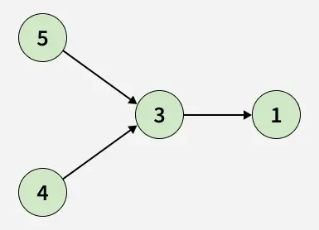
Example
Output: 4->5->3->1 or 5->4->3->1

Slide 4
Directed Acyclic Graph(DAG)
DAGs are graphs where each edge is directed and no cycle exists in the graph.
Why Topological Sort is not possible for graphs with undirected edges or cycles?
Undirected Graph:
Every edge u–v can be seen as both u→v and v→u, so you can’t decide
which one should come first.
Cyclic Graph:
Let's say the graph contains the cycle, u→v→w→u, then you’d need u
before v, v before w, and w before u — impossible to satisfy.

Slide 5
Topological sorting using Kahn’s Algorithm
The idea is to use Kahn’s Algorithm, which applies BFS to generate a valid topological ordering.
We first compute the in-degree of every vertex — representing how many incoming edges each vertex has. Then, all vertices with an in-degree of 0 are added to a queue, as they can appear first in the ordering.
We repeatedly remove a vertex from the queue, add it to our result list, and reduce the in-degree of all its adjacent vertices. If any of those vertices now have an in-degree of 0, they are added to the queue.
This process continues until the queue is empty, and the resulting order represents one valid topological sort of the graph.

Slide 6
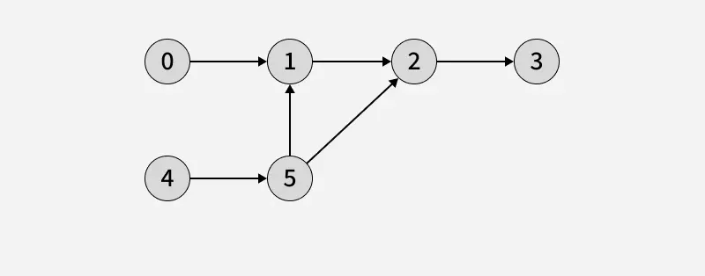
Kahn’s Algorithm-Example

Slide 7
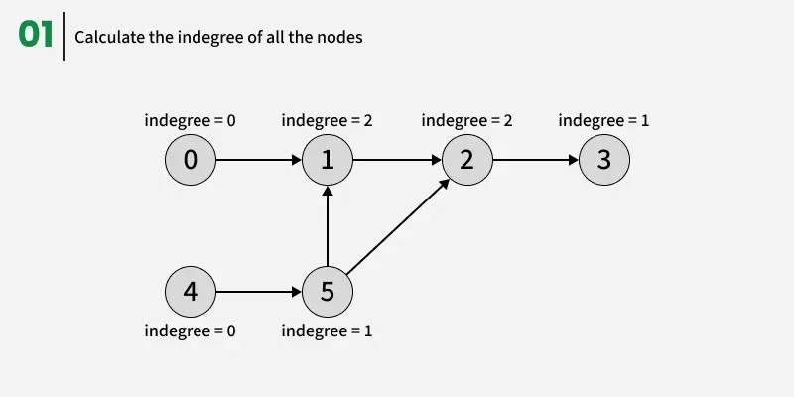
Kahn’s Algorithm-Example

Slide 8
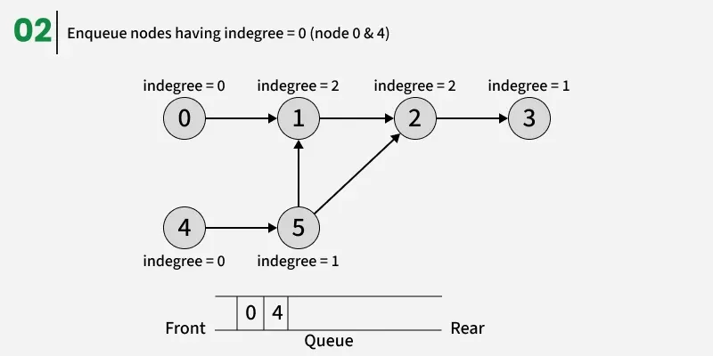
Kahn’s Algorithm-Example

Slide 9
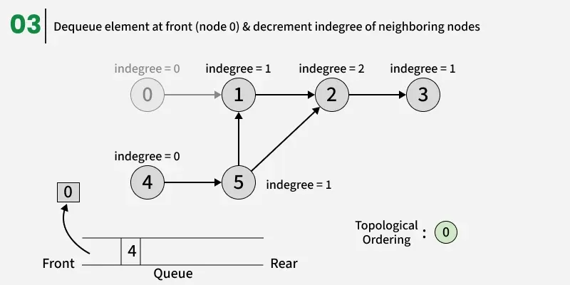
Kahn’s Algorithm-Example

Slide 10
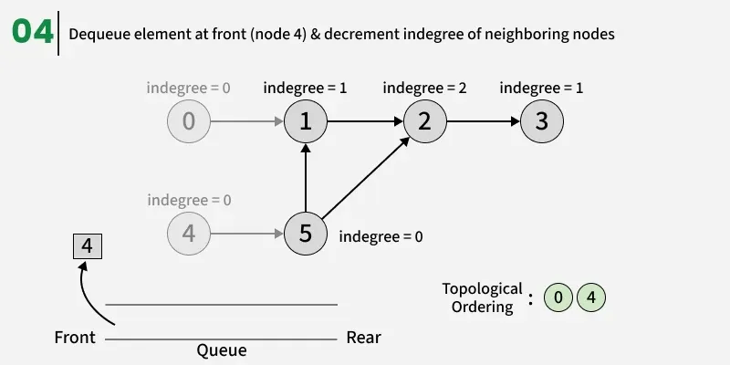
Kahn’s Algorithm-Example

Slide 11
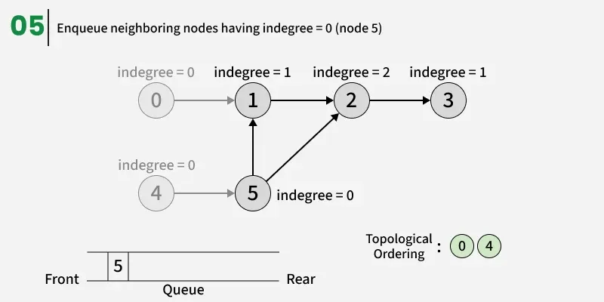
Kahn’s Algorithm-Example

Slide 12
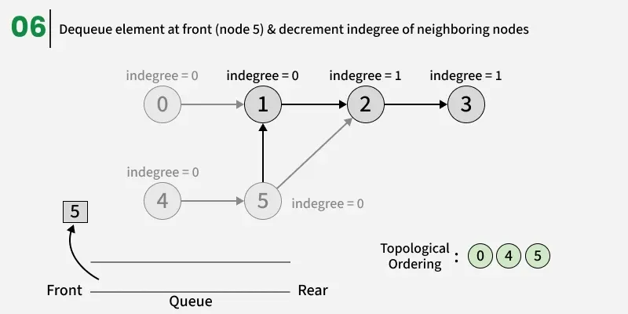
Kahn’s Algorithm-Example

Slide 13
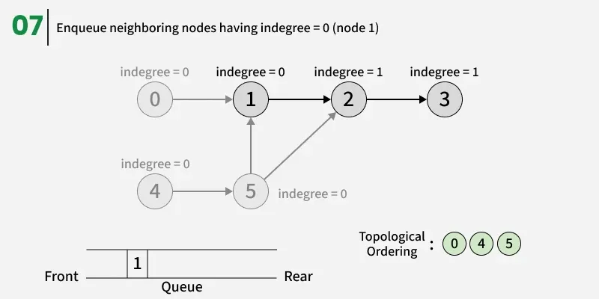
Kahn’s Algorithm-Example

Slide 14
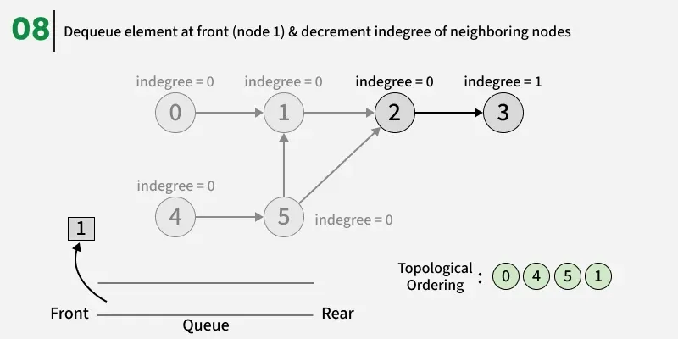
Kahn’s Algorithm-Example

Slide 15
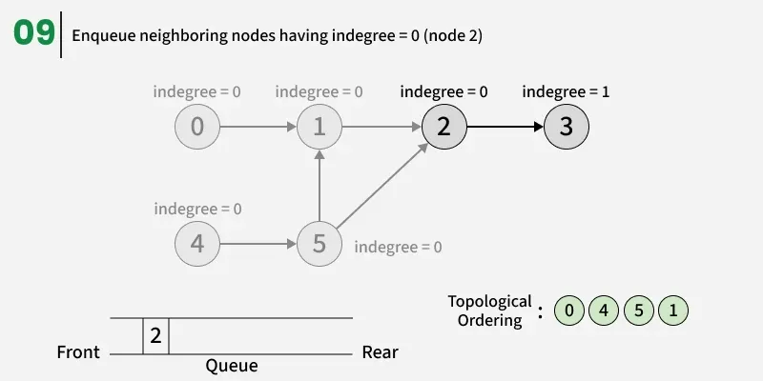
Kahn’s Algorithm-Example

Slide 16
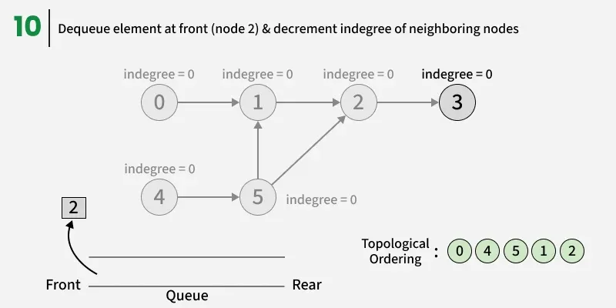
Kahn’s Algorithm-Example

Slide 17
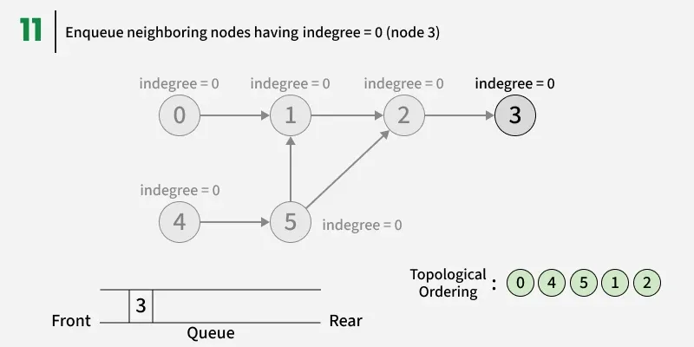
Kahn’s Algorithm-Example

Slide 18
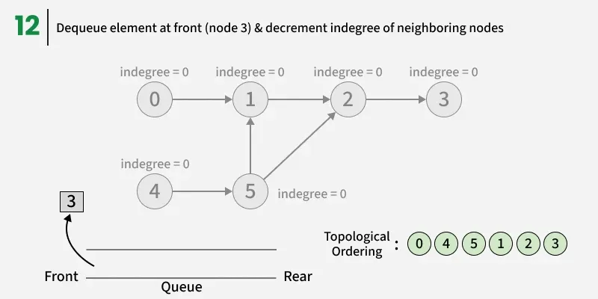
Kahn’s Algorithm-Example

Slide 19
Kahn’s Algorithm-Example

Slide 20
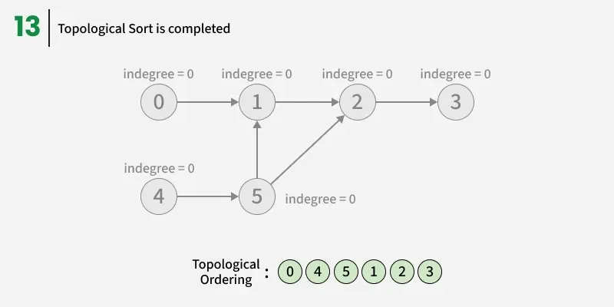
Kahn’s Algorithm-Example

Slide 21
Topological Sorting using DFS
The idea is to perform a DFS traversal starting from every unvisited vertex (from 0 to n − 1).
For each DFS call, we first explore all unvisited neighbors of the current node.
Once the recursive calls for all its neighbors are complete, we start pushing these nodes into a stack while backtracking.
After all vertices are processed, we pop elements from the stack one by one into a list — this gives a valid topological ordering, as each node is placed before all nodes it points to.

Slide 22
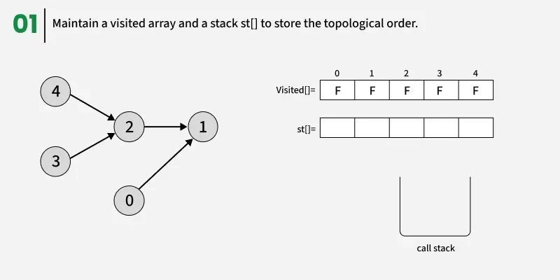
DFS-Example

Slide 23
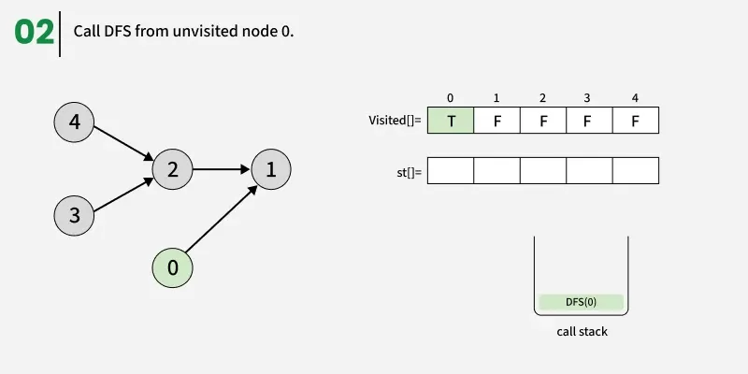
DFS-Example

Slide 24
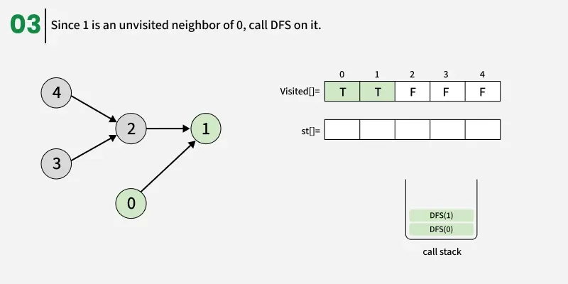
DFS-Example

Slide 25
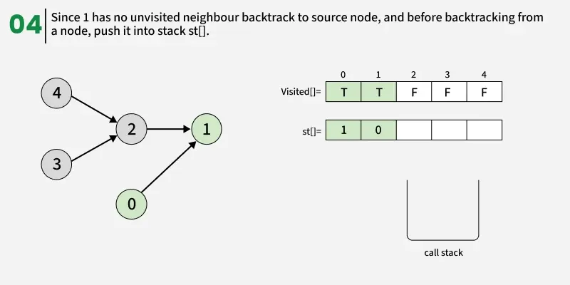
DFS-Example

Slide 26
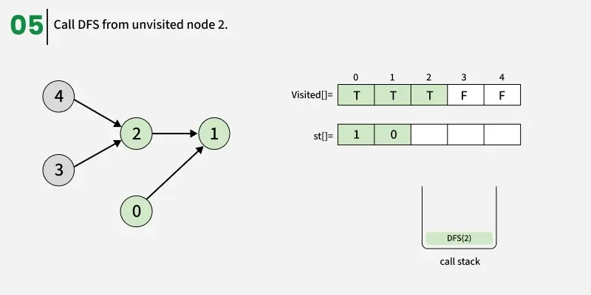
DFS-Example

Slide 27
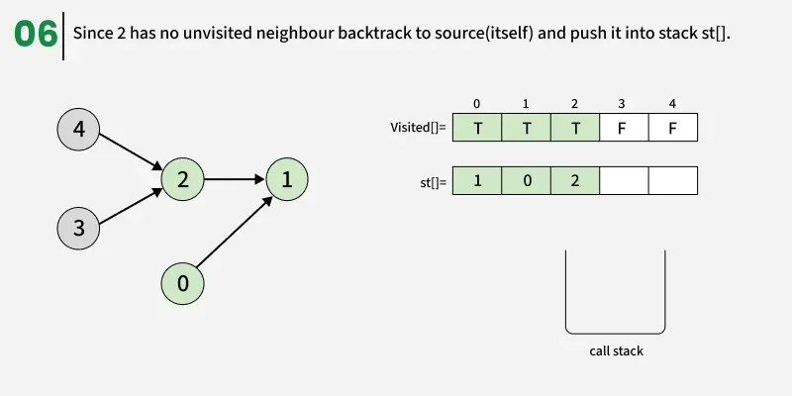
DFS-Example

Slide 28
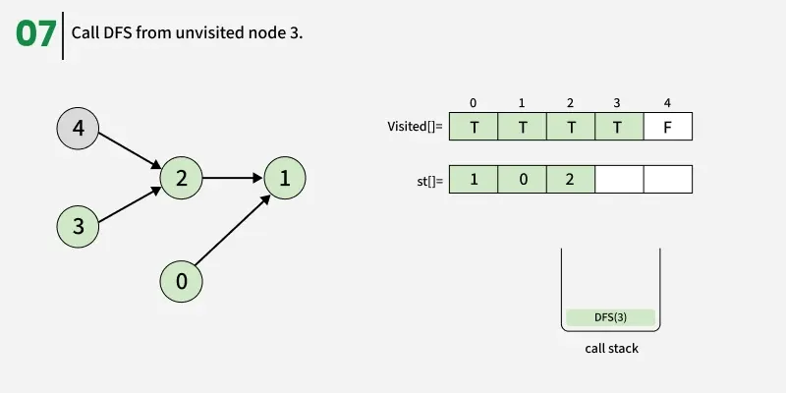
DFS-Example

Slide 29
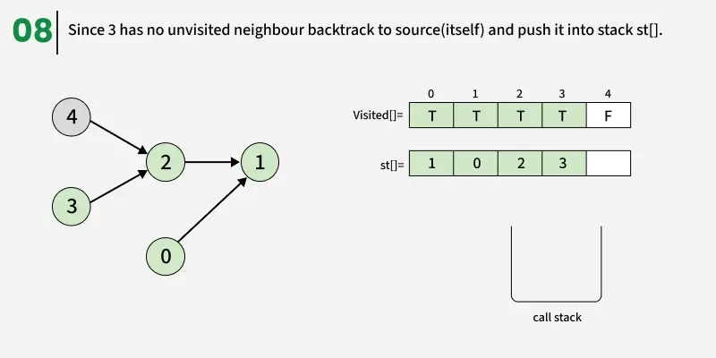
DFS-Example

Slide 30
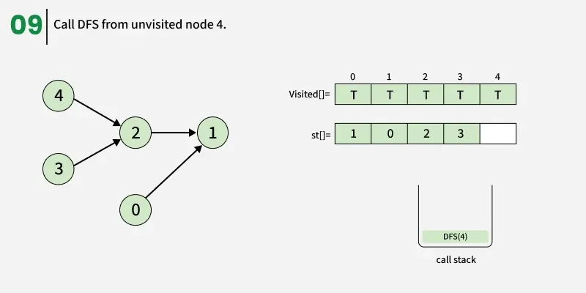
DFS-Example

Slide 31
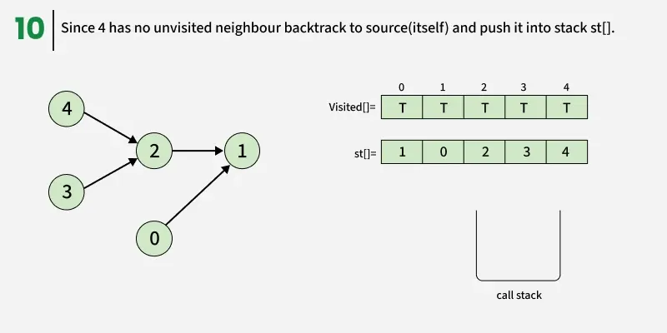
DFS-Example

Slide 32
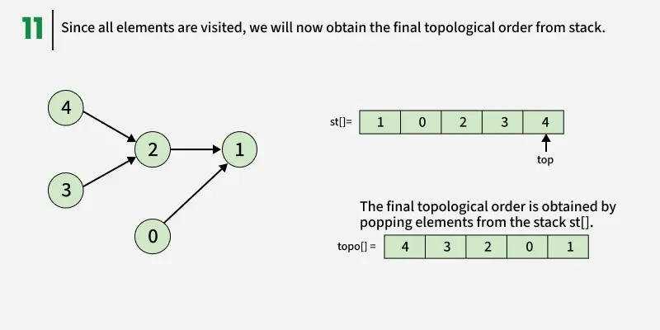
DFS-Example

Slide 33
Thank You

